Slide 1


Introduction to Data Analysis
Module lecturer: Dr. Othmane Cherqi (othmane.cherqi@uir.ac.ma)
Lab instructors:
Ms. Safaa Berkani
M. Abdelghani Ghanem
24/09/2024

Slide 2
The Role of a Data Analyst

Slide 3
The Role of a Data Analyst
General process of investigation:

Slide 4
The Role of a Data Analyst
General process of investigation:
1. Identify a question or problem: Begin by defining a clear and specific question or problem that
needs to be addressed.

Slide 5
The Role of a Data Analyst
General process of investigation:
Identify a question or problem: Begin by defining a clear and specific question or problem that
needs to be addressed.
Collect relevant data on the topic: Gather data that is pertinent to the question or problem at hand.

Slide 6
The Role of a Data Analyst
General process of investigation:
Identify a question or problem: Begin by defining a clear and specific question or problem that
needs to be addressed.
Collect relevant data on the topic: Gather data that is pertinent to the question or problem at hand.
Analyze the data: Employ statistical methods and tools to examine and make sense of the data.

Slide 7
The Role of a Data Analyst
General process of investigation:
Identify a question or problem: Begin by defining a clear and specific question or problem that
needs to be addressed.
Collect relevant data on the topic: Gather data that is pertinent to the question or problem at hand.
Analyze the data: Employ statistical methods and tools to examine and make sense of the data.
Form a conclusion: Based on the analysis, draw meaningful conclusions or insights.

Slide 8

The Role of a Data Analyst
Walmart Beer and Nappies Story:
A major retail chain in the 1990s analyzed sales data and discovered a surprising correlation between beer and diaper purchases.

Slide 9
The Role of a Data Analyst
Walmart Beer and Nappies Story:
A major retail chain in the 1990s analyzed sales data and discovered a surprising correlation between beer and diaper purchases.
Further analysis revealed that young fathers often bought beer as a treat when picking up diapers.

Slide 10
The Role of a Data Analyst
Walmart Beer and Nappies Story:
A major retail chain in the 1990s analyzed sales data and discovered a surprising correlation between beer and diaper purchases.
Further analysis revealed that young fathers often bought beer as a treat when picking up diapers.
The retailer strategically placed beer near diapers in stores, leading to increased sales of both products.

Slide 11
The Role of a Data Analyst
Statistics Provides Essential Tools:

Slide 12
The Role of a Data Analyst
Statistics Provides Essential Tools:
Statistics provides data analysts with essential tools to:

Slide 13
The Role of a Data Analyst
Statistics Provides Essential Tools:
Statistics provides data analysts with essential tools to:
Effectively collect data.

Slide 14
The Role of a Data Analyst
Statistics Provides Essential Tools:
Statistics provides data analysts with essential tools to:
Effectively collect data.
Appropriately analyze data.

Slide 15
The Role of a Data Analyst
Statistics Provides Essential Tools:
Statistics provides data analysts with essential tools to:
Effectively collect data.
Appropriately analyze data.
Draw meaningful inferences from the analysis.

Slide 16
Aim of this Module
Aim of this module:
Understand Raw Data: Learn what the data is telling you.
Visualize Data: Make graphs or pictures to see data patterns.
Clean Data: Fix errors or missing parts in the data.
Formulate Questions: Turn real-life questions into math or statistics problems.
Choose Analysis Techniques: Pick the best method to get answers from data.
Assess Answers: Use math to make sure your answers are correct.

Slide 17

Module structure
Introduction to Data
Summarizing Data
Probability
Distributions of Random Variables
Foundations for Inference
Inference for Categorical Data
Inference for Numerical Data
Textbook: (https://www.openintro.org/)
14

Slide 18
Assessment
Lab assignments (15%)
Midterm exam (40%)
Final exam (45%)

Slide 19
Chapter 1: Introduction to data
Case study: The Effectiveness of Studying Methods on Exam Performance
Objective: Evaluate the effectiveness of group study vs. individual study for exam preparation.
Potential Participants: 142 students from a large introductory course.
Study Participants: 60 out of the 142 students participated in the study. Some didn't meet the study criteria (like consistent attendance), some had other commitments, and some just didn't want to be part of the study.
Study Method Assignment: Students were randomly divided into two groups, 30 students in each group:
Group Study Participants: students studied collaboratively, discussing and teaching each other.
Solo Study Participants: students studied alone without discussing with peers.

Slide 20
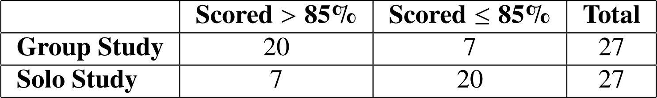
Chapter 1: Introduction to data
Results after the Exam:
The table below shows the distribution of students who scored above 85%. Note that 6 students did not
sit for the exam: 3 from the group study and 3 from the solo study.

Slide 21
Chapter 1: Introduction to data
Results after the Exam:
The table below shows the distribution of students who scored above 85%. Note that 6 students did not
sit for the exam: 3 from the group study and 3 from the solo study.
Analysis:
Proportion scoring >85% among Group Study Participants: 20/27 ≈ 0.74 → 74%
Proportion scoring >85% among Solo Study Participants: 7/27 ≈ 0.26 → 26%

Slide 22
Chapter 1: Introduction to data
Discussion Question:

Slide 23
Chapter 1: Introduction to data
Discussion Question:
1. Do the data show a significant difference in the effectiveness of group study versus
solo study for exam preparation?

Slide 24
Chapter 1: Introduction to data
Discussion Question:
1. Do the data show a significant difference in the effectiveness of group study versus
solo study for exam preparation?
What if the group study participants were mostly students who were already high achievers or who had more time to dedicate to studying?

Slide 25
Chapter 1: Introduction to data
Discussion Question:
1. Do the data show a significant difference in the effectiveness of group study versus
solo study for exam preparation?
What if the group study participants were mostly students who were already high achievers or who had more time to dedicate to studying?
Or what if the solo study group included students who were struggling with the material or had other commitments that limited their study time?

Slide 26
Chapter 1: Introduction to data
Discussion Question:
1. Do the data show a significant difference in the effectiveness of group study versus
solo study for exam preparation?
What if the group study participants were mostly students who were already high achievers or who had more time to dedicate to studying?
Or what if the solo study group included students who were struggling with the material or had other commitments that limited their study time?
In this case, the results might not reflect the real effectiveness of group vs. solo study. Instead, it could simply be that good students ended up in the group study, and average or struggling students were in solo study, creating a bias.
Notes:
Random Chance: How It Could Affect the Results:
Small Sample Size: If we only tested the two study methods on a small number of students (like 10 in each group), we might observe a difference simply by chance. In a small group, it's easier for random fluctuations (e.g., a few particularly strong or weak students) to skew the results.
For example:

Slide 27
Chapter 1: Introduction to data
Understanding the results:
Suppose you flip a coin 100 times. While the chance a coin lands heads in any given coin flip is 50%,
we probably won’t see exactly 50 heads. This kind of difference happens often when we collect data.

Slide 28
Chapter 1: Introduction to data
Understanding the results:
Suppose you flip a coin 100 times. While the chance a coin lands heads in any given coin flip is 50%,
we probably won’t see exactly 50 heads. This kind of difference happens often when we collect data.
The big difference between the Group Study and Solo Study students (74% - 26% = 48%) might be because group study is really better, or it could just be by chance.
Because the difference is big, it seems more likely that group studying helps students score better.
To be sure about this difference, we need special tools from statistics.
Notes:
The point is that in a smaller sample (10 flips), it’s more likely to get extreme results (e.g., 8 heads out of 10). But in a larger sample (100 flips), the result will likely be closer to 50%. Similarly, in a larger, well-designed study, randomness plays a smaller role, and the results are more likely to reflect reality.

Slide 29
Chapter 1: Introduction to data
Discussion Question:
2. Are the results of this study generalizable to all students in all courses?

Slide 30
Chapter 1: Introduction to data
Discussion Question:
2. Are the results of this study generalizable to all students in all courses?
These students are from a specific course and chose to join this study. So, they might not represent all students. While we can't immediately say these results apply to all students, this study is a good start. Group study worked for these students, and that gives hope it might help others too.

Slide 31
Chapter 1: Introduction to data
Data basics:
A survey was conducted on students in an introductory statistics course. Below are a few of the questions on the survey, and the corresponding variables the data from the responses were stored in:
gender: What is your gender?
sleep: How many hours do you sleep at night, on average?
bedtime: What time do you usually go to bed?
countries: How many countries have you visited?

Slide 32
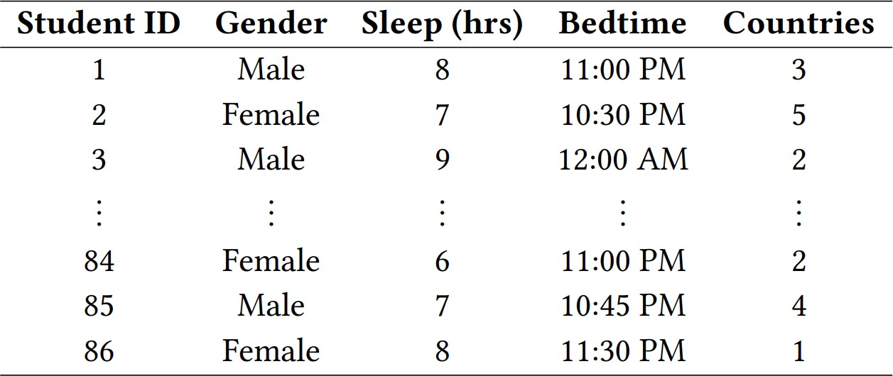
Chapter 1: Introduction to data
Data basics:
Data collected on students in a statistics class on a variety of variables:

Slide 33
Chapter 1: Introduction to data
Data basics:
Data collected on students in a statistics class on a variety of variables:
Variable

Slide 34
Chapter 1: Introduction to data
Data basics:
Data collected on students in a statistics class on a variety of variables:
Observation

Slide 35
Chapter 1: Introduction to data
Types of variables
All variables

Slide 36
Chapter 1: Introduction to data
Types of variables
Is it a quantity ?
Yes
All variables
Numerical
Categorical
No

Slide 37
Chapter 1: Introduction to data
Data basics:
Data collected on students in a statistics class on a variety of variables:
Categorigal
Categorigal
Numerical
Numerical
Numerical

Slide 38
Chapter 1: Introduction to data
Types of variables
Is it a quantity ?
Yes
All variables
No order
Measure
Numerical
Categorical
No
Continuous
Discrete
Regular categorical
Ordinal
(e.g., time = 17.5 min)
(e.g., number of children = 2)
(e.g., eye color: blue, brown, green)
Order
(e.g., satisfaction level: poor, fair, good, excellent)
Count

Slide 39
Chapter 1: Introduction to data
Types of variables
Gender:

Slide 40
Chapter 1: Introduction to data
Types of variables
Gender: Categorical

Slide 41
Chapter 1: Introduction to data
Types of variables
Gender: Categorical Sleep:

Slide 42
Chapter 1: Introduction to data
Types of variables
Gender: Categorical
Sleep: Numerical, continuous

Slide 43
Chapter 1: Introduction to data
Types of variables
Gender: Categorical
Sleep: Numerical, continuous
Bedtime:

Slide 44
Chapter 1: Introduction to data
Types of variables
Gender: Categorical
Sleep: Numerical, continuous
Bedtime: Numetical, continuous

Slide 45
Chapter 1: Introduction to data
Types of variables
Gender: Categorical
Sleep: Numerical, continuous
Bedtime: Numerical , continuous Countries:

Slide 46
Chapter 1: Introduction to data
Types of variables
Gender: Categorical
Sleep: Numerical, continuous
Bedtime: Numerical , continuous Countries: numerical, discrete

Slide 47
Chapter 1: Introduction to data
Practice
What type of variable is a telephone area code?
Numerical, continuous
Numerical, discrete
Categorical
Categorical, ordinal

Slide 48
Chapter 1: Introduction to data
Practice
What type of variable is a telephone area code?
Numerical, continuous
Numerical, discrete
Categorical
Categorical, ordinal

Slide 49
Chapter 1: Introduction to data
Relationships among variables

Slide 50
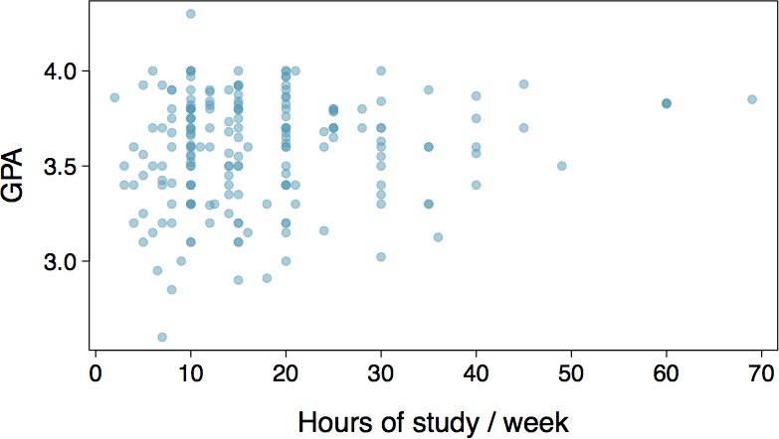
Chapter 1: Introduction to data
Relationships among variables
Does there appear to be a relationship between Grade Point Average (GPA) and number
of hours students study per week?

Slide 51
Chapter 1: Introduction to data
Relationships among variables
Does there appear to be a relationship between Grade Point Average (GPA) and number
of hours students study per week?
Can you spot anything unusual about any of the data points?

Slide 52
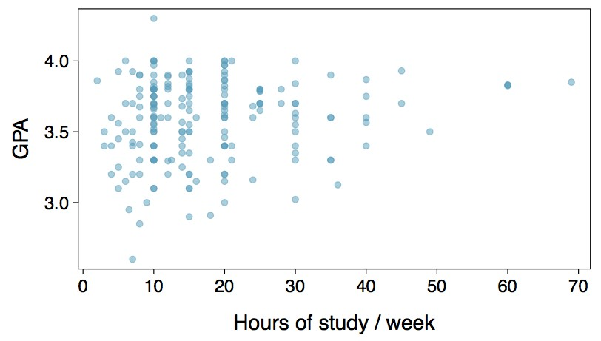
Chapter 1: Introduction to data
Relationships among variables
Does there appear to be a relationship between Grade Point Average (GPA) and number
of hours students study per week?
Can you spot anything unusual about any of the data points?
There is one student with GPA > 4.0, this is likely a data error.

Slide 53
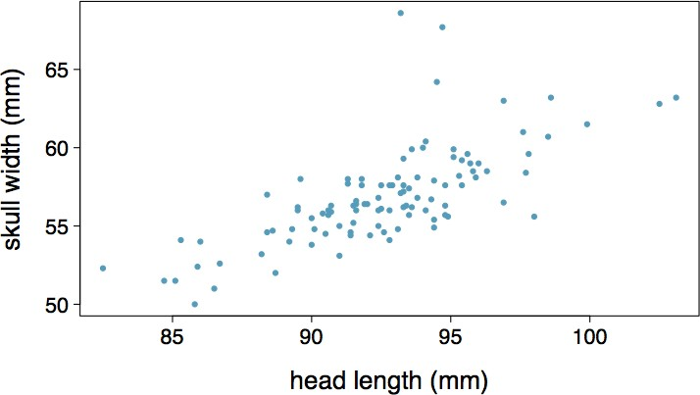
Chapter 1: Introduction to data
Practice:
Based on the scatterplot on the right, which of
the following statements is correct about the head and skull lengths of possums?
There is no relationship between head length and skull width, i.e. the variables are independent.
Head length and skull width are positively associated.
Skull width and head length are negatively associated.
A longer head causes the skull to be wider.
A wider skull causes the head to be longer.

Slide 54
Chapter 1: Introduction to data
Practice:
Based on the scatterplot on the right, which of
the following statements is correct about the head and skull lengths of possums?
There is no relationship between head length and skull width, i.e. the variables are independent.
Head length and skull width are positively associated.
Skull width and head length are negatively associated.
A longer head causes the skull to be wider.
A wider skull causes the head to be longer.

Slide 55
Chapter 1: Introduction to data
Associated vs. independent
When two variables show some connection with one another, they are called associated variables.
o Associated variables can also be called dependent variables and vice-versa.
If two variables are not associated, i.e. there is no evident connection between the two, then they are said to be independent.

Slide 56
Chapter 1: Introduction to data
Sampling Principles and Strategies
Understanding the Core Concepts

Slide 57

Chapter 1: Introduction to data
Sampling Principles and Strategies
Understanding the Core Concepts
Definition: Sampling is the process of selecting a subset of individuals from a population to estimate population parameters.

Slide 58
Chapter 1: Introduction to data
Sampling Principles and Strategies
Importance of Sampling:
It's impractical to study an entire population.
Samples provide a feasible way to gather data.
Proper sampling can give accurate representations of the whole.

Slide 59
Chapter 1: Introduction to data
Sampling Principles and Strategies
Key Principles:
Randomness: Every member should have an equal chance of selection.
Representation: The sample should mirror the population's diversity.
Size: Larger samples are usually better, but not always by much.

Slide 60
Chapter 1: Introduction to data
Sampling Principles and Strategies
Types of Sampling:
Random Sampling
Stratified Sampling
Cluster Sampling

Slide 61
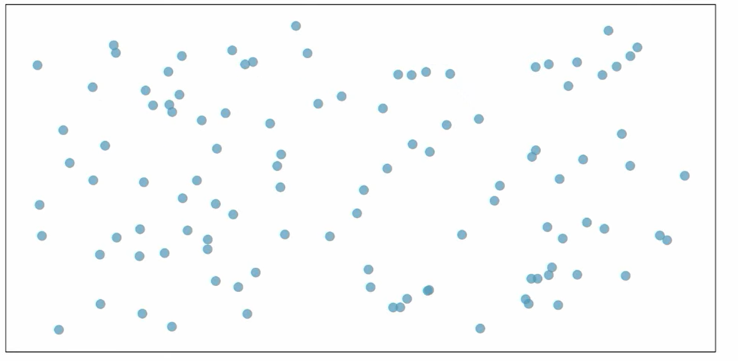
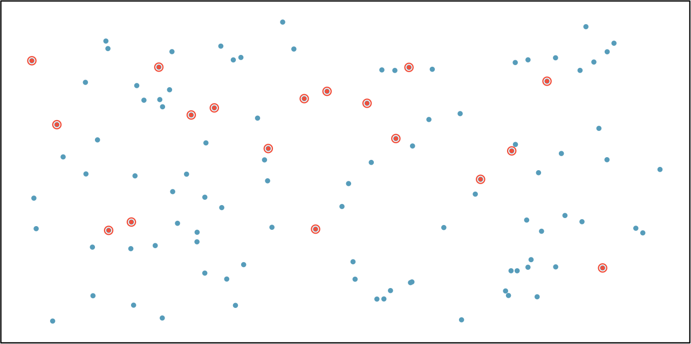
Chapter 1: Introduction to data
Sampling Principles and Strategies
Use case: Studying La Liga Players’ Salaries Population: 499 players across 20 teams in La Liga.
Random Sampling:
o Randomly select 120 cases (players) from the population, where there is no implied connection between the points that are selected.

Slide 62
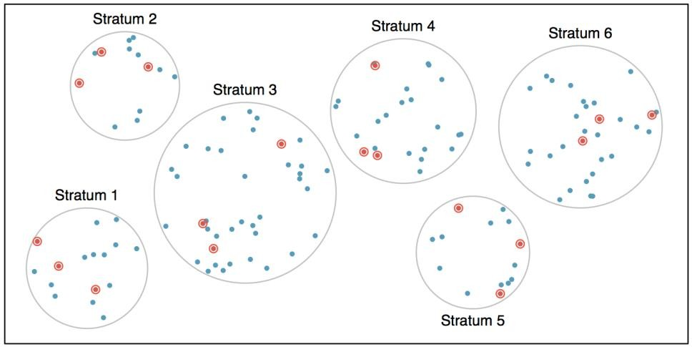
Chapter 1: Introduction to data
Sampling Principles and Strategies
Stratified Sampling:
o Population divided into subgroups (strata) based on a characteristic (team). Then samples are taken proportionally from each subgroup.

Slide 63
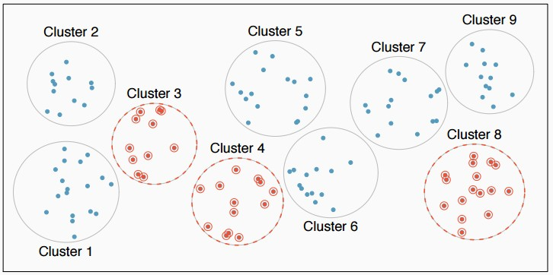
Chapter 1: Introduction to data
Sampling Principles and Strategies
Cluster Sampling:
o Population divided into clusters. A random sample of clusters is chosen, and all members in chosen clusters are surveyed.

Slide 64
Chapter 1: Introduction to data
Sampling Principles and Strategies
Sampling Errors:
Selection Bias: When some members have a lower or higher probability of being chosen.
Non-response Bias: When respondents differ from non-respondents, skewing the sample.
Undercoverage: When some groups are left out or underrepresented.

Slide 65
Chapter 1: Introduction to data
Sampling Principles and Strategies
Practice:
A city council has requested a household survey be conducted in a suburban area of their city. The area is broken into many distinct and unique neighborhoods, some including large homes, some with only apartments. Which approach would likely be the least effective?
Simple random sampling
Cluster sampling
Stratified sampling
Blocked sampling

Slide 66
Chapter 1: Introduction to data
Sampling Principles and Strategies
Practice:
A city council has requested a household survey be conducted in a suburban area of their city. The area is broken into many distinct and unique neighborhoods, some including large homes, some with only apartments. Which approach would likely be the least effective?
Simple random sampling
Cluster sampling
Stratified sampling
Blocked sampling

Slide 67
Chapter 1: Introduction to data
Do you have any questions?

Slide 68
Chapter 1: Introduction to data
Do you have any questions?

Slide 69
Chapter 1: Introduction to data
Exercices
Light and exam performance. A study is designed to test the effect of light level on exam performance of students. The researcher believes that light levels might have different effects on males and females, so wants to make sure both are equally represented in each treatment. The treatments are fluorescent overhead lighting, yellow overhead lighting, no overhead lighting (only desk lamps).
What is the response variable?
What is the explanatory variable? What are its levels?
What is the blocking variable? What are its levels?

Slide 70
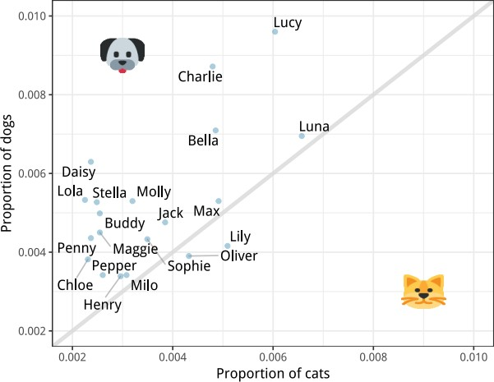
Chapter 1: Introduction to data
Exercices
Pet names. The city of Seattle, WA has an open data portal that includes pets registered in the city. For each registered pet, we have information on the pet’s name and species. The following visualization plots the proportion of dogs with a given name versus the proportion of cats with the same name. The 20 most common cat and dog names are displayed. The diagonal line on the plot is the x = y line; if a name appeared on this line, the name’s popularity would be exactly the same for dogs and cats.
Are these data collected as part of an experiment or an observational study?
What is the most common dog name? What is the most common cat name?
What names are more common for cats than dogs?
Is the relationship between the two variables positive or negative? What does this mean in context of the data?

